Slide 1
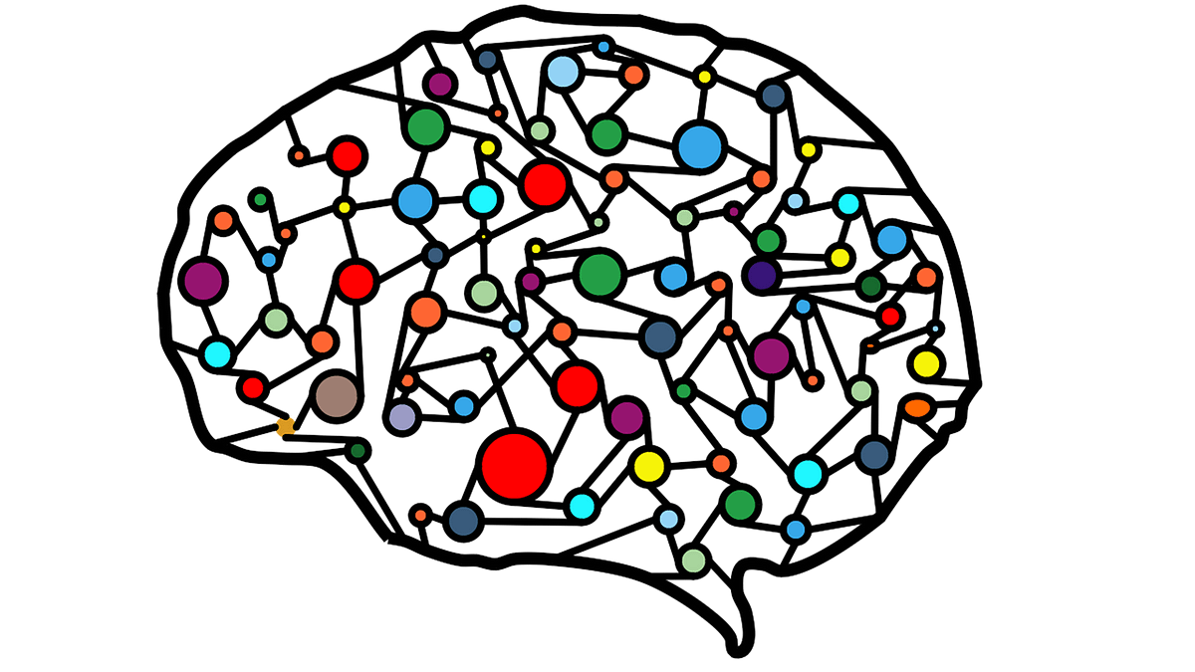
Data Preprocessing
Data Mining: Concepts and Techniques
Chapter 3
Prepared by:
Muhammad Atif Saeed
January 28, 2026

Slide 2
Table of Content
Data Preprocessing: An Overview
Data Quality
Major Tasks in Data Preprocessing
Data Cleaning
Data Integration
Data Reduction
Data Transformation and Data Discretization
Summary
SLIDE 02
Muhammad Atif Saeed | MS-DS | Air University, Islamabad

Slide 3
Data Preprocessing: An Overview
Data preprocessing forms the foundation of any successful machine learning project, as it directly impacts the quality and effectiveness of the models we build.
Preparing our data correctly ensures that the models can extract meaningful patterns and insights, leading to accurate predictions and valuable insights.
Raw data is often messy, incomplete, and inconsistent. It may contain noise, irrelevant information, and outliers that can negatively impact the performance of machine learning models. Data preprocessing aims to clean, transform, and restructure the data so that it becomes suitable for model training.
SLIDE 03

Slide 4
Data Quality: Why Preprocess the Data?
Measures for data quality: A multidimensional view
Accuracy: correct or wrong, accurate or not
Completeness: not recorded, unavailable, …
Consistency: some modified but some not, dangling, …
Timeliness: timely update?
Believability: how trustable the data are correct?
Interpretability: how easily the data can be understood?
SLIDE 04

Slide 5
Major Tasks in Data Preprocessing
Data cleaning
  Fill in missing values, smooth noisy data, identify or remove outliers, and resolve inconsistencies
Data integration
  Integration of multiple databases, data cubes, or files
Data reduction
  Dimensionality reduction
  Numerosity reduction
  Data compression
Data transformation and data discretization
  Normalization
  Concept hierarchy generation
SLIDE 05

Slide 6
Data Cleaning
Data in the Real World Is Dirty: Lots of potentially incorrect data, e.g., instrument faulty, human or computer error, transmission error
  incomplete: lacking attribute values, lacking certain attributes of interest, or containing only aggregate data
    e.g., Occupation=“ ” (missing data)
  noisy: containing noise, errors, or outliers
    e.g., Salary=“−10” (an error)
  inconsistent: containing discrepancies in codes or names, e.g.,
    Age=“42”, Birthday=“03/07/2010”
    Was rating “1, 2, 3”, now rating “A, B, C”
    discrepancy between duplicate records
  Intentional (e.g., disguised missing data)
    Jan. 1 as everyone’s birthday?
SLIDE 06

Slide 7
Incomplete (Missing) Data
Data is not always available
  E.g., many tuples have no recorded value for several attributes, such as customer income in sales data
Missing data may be due to
  equipment malfunction
  inconsistent with other recorded data and thus deleted
  data not entered due to misunderstanding
  certain data may not be considered important at the time of entry
  not register history or changes of the data
Missing data may need to be inferred
SLIDE 07

Slide 8
How to Handle Missing Data?
Ignore the tuple: usually done when class label is missing (when doing classification)—not effective when the % of missing values per attribute varies considerably
Fill in the missing value manually: tedious + infeasible?
Fill in it automatically with
  a global constant : e.g., “unknown”, a new class?!
  the attribute mean
  the attribute mean for all samples belonging to the same class: smarter
  the most probable value: inference-based such as Bayesian formula or decision tree
SLIDE 08

Slide 9
Noisy Data
Noise: random error or variance in a measured variable
Incorrect attribute values may be due to
  Faulty data collection instruments
  Data entry problems
  Data transmission problems
  Technology limitation
  Inconsistency in naming convention
Other data problems which require data cleaning
  Duplicate records
  Incomplete data
  Inconsistent data
SLIDE 09

Slide 10
How to Handle Noisy Data?
Binning
  First sort data and partition into (equal-frequency) bins
  Then one can smooth by bin means, smooth by bin median, smooth by bin boundaries, etc.
Regression
  Smooth by fitting the data into regression functions
Clustering
  Detect and remove outliers
Combined computer and human inspection
  Detect suspicious values and check by human (e.g., deal with possible outliers)
SLIDE 10

Slide 11
Data Reduction Strategies
Data reduction: Obtain a reduced representation of the data set that is much smaller in volume but yet produces the same (or almost the same) analytical results
Why data reduction? — A database/data warehouse may store terabytes of data. Complex data analysis may take a very long time to run on the complete data set.
Data reduction strategies
  Dimensionality reduction, e.g., remove unimportant attributes
  Numerosity reduction (some simply call it: Data Reduction)
    Clustering, sampling
Data compression
SLIDE 11

Slide 12
Data Normalization
Min-max normalization: to [new_minA, new_maxA]
  Ex. Let income range $12,000 to $98,000 normalized to [0.0, 1.0]. Then $73,000 is mapped to
Z-score normalization (μ: mean, σ: standard deviation):
  Ex. Let μ = 54,000, σ = 16,000. Then
Normalization by decimal scaling
SLIDE 12

Slide 13
Summary
Data quality: accuracy, completeness, consistency, timeliness, believability, interpretability
Data cleaning: e.g. missing/noisy values, outliers
Data integration from multiple sources:
  Entity identification problem
  Remove redundancies
  Detect inconsistencies
Data reduction
  Dimensionality reduction
  Numerosity reduction
  Data compression
Data transformation and data discretization
  Normalization
  Concept hierarchy generation
SLIDE 13

Slide 14
References
D. P. Ballou and G. K. Tayi. Enhancing data quality in data warehouse environments. Comm. of ACM, 42:73-78, 1999
A. Bruce, D. Donoho, and H.-Y. Gao. Wavelet analysis. IEEE Spectrum, Oct 1996
T. Dasu and T. Johnson. Exploratory Data Mining and Data Cleaning. John Wiley, 2003
J. Devore and R. Peck. Statistics: The Exploration and Analysis of Data. Duxbury Press, 1997.
H. Galhardas, D. Florescu, D. Shasha, E. Simon, and C.-A. Saita. Declarative data cleaning: Language, model, and algorithms. VLDB'01
M. Hua and J. Pei. Cleaning disguised missing data: A heuristic approach. KDD'07
H. V. Jagadish, et al., Special Issue on Data Reduction Techniques. Bulletin of the Technical Committee on Data Engineering, 20(4), Dec. 1997
H. Liu and H. Motoda (eds.). Feature Extraction, Construction, and Selection: A Data Mining Perspective. Kluwer Academic, 1998
J. E. Olson. Data Quality: The Accuracy Dimension. Morgan Kaufmann, 2003
D. Pyle. Data Preparation for Data Mining. Morgan Kaufmann, 1999
V. Raman and J. Hellerstein. Potters Wheel: An Interactive Framework for Data Cleaning and Transformation, VLDB’2001
T. Redman. Data Quality: The Field Guide. Digital Press (Elsevier), 2001
R. Wang, V. Storey, and C. Firth. A framework for analysis of data quality research. IEEE Trans. Knowledge and Data Engineering, 7:623-640, 1995
SLIDE 14

